Slide 1
Supply Chain Management
11

Slide 2
Supply-Chain Management
Objective
Structure the supply chain to maximize its competitive advantage and benefits to the ultimate consumer
Involves
Coordination of all supply chain activities, starting with raw materials and ending with a satisfied customer
Includes
Suppliers, manufacturers and/or service providers, distributors, wholesalers, retailers, and final customers

Slide 3
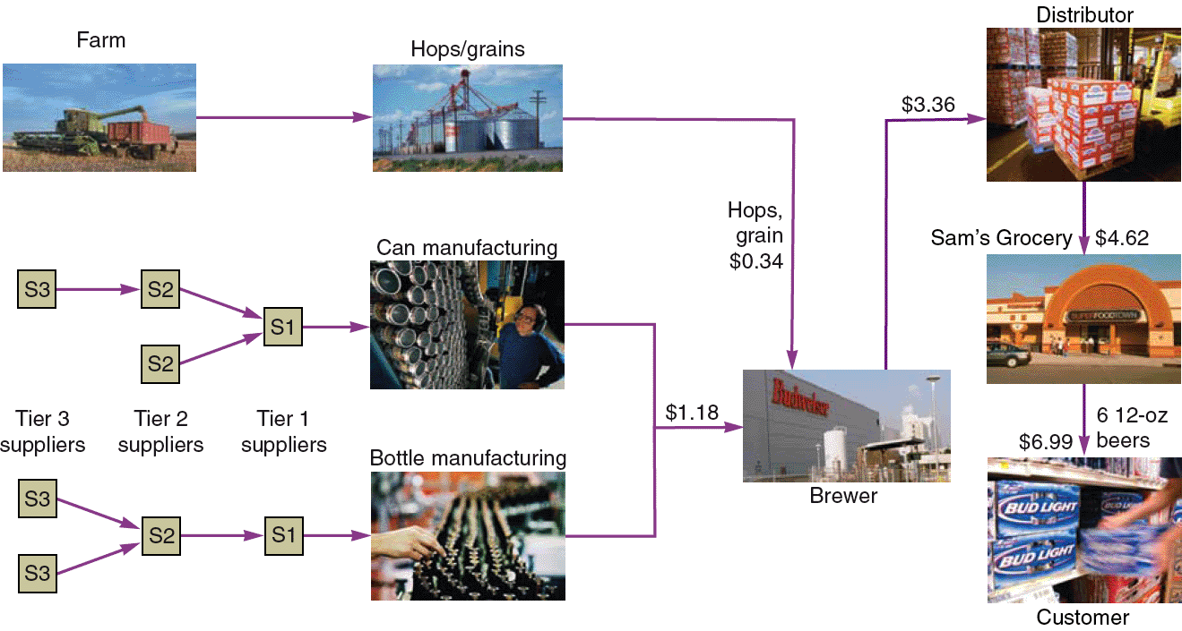
A Supply Chain for Beer
Figure 11.1

Slide 4
Supply Chain vs. Sales Strategy
Hau Lee Furniture
60% of sales $ in supply chain Current gross profit = $10,000 Increase profits to $15,000 (50%)
Table 11.2 - Low cost vs Response vs Differentiation

Slide 5
Sourcing Issues
Make-or-buy decisions
Choosing between obtaining products and services externally as opposed to producing them internally
Outsourcing
Transfer traditional internal activities and resources to outside vendors
Efficiency in specialization
Focus on core competencies

Slide 6
Six Sourcing Strategies
Many suppliers
Few suppliers
Vertical integration
Joint ventures
Keiretsu networks
Virtual companies

Slide 7
Many Suppliers
Commonly used for commodity products
Purchasing is typically based on price
Suppliers compete with one another
Supplier is responsible for technology, expertise, forecasting, cost, quality, and delivery
Example: Milk at Walmart

Slide 8
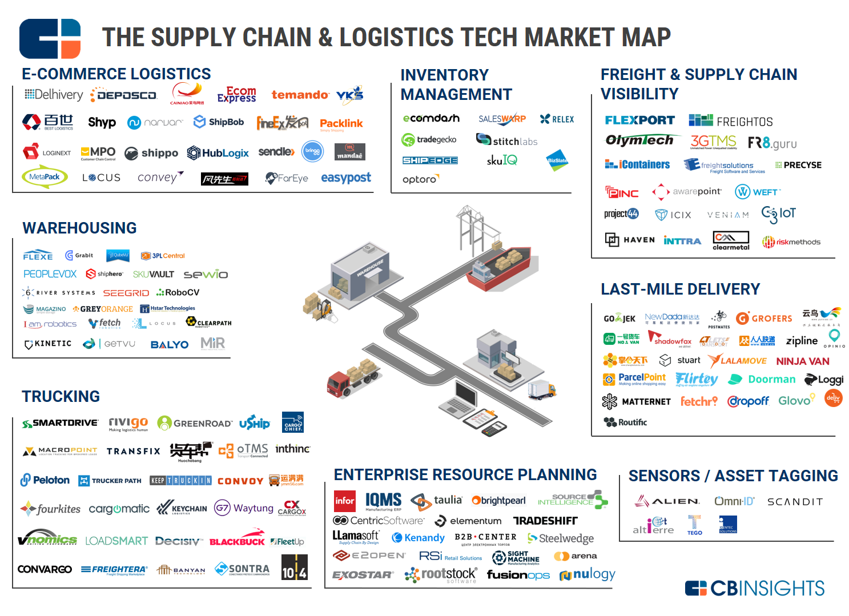
Choosing a Supplier!
https://www.cbinsights.com/research/supply-chain-logistics-tech-infographic/

Slide 9
Few Suppliers
Buyer forms longer-term relationships with fewer suppliers
Create value through economies of scale and learning curve improvements
Suppliers more willing to participate in JIT programs and contribute design and technological expertise
Cost of changing suppliers is huge
Trade secrets and other alliances may be at risk
Example: Washing machine part for EB

Slide 10
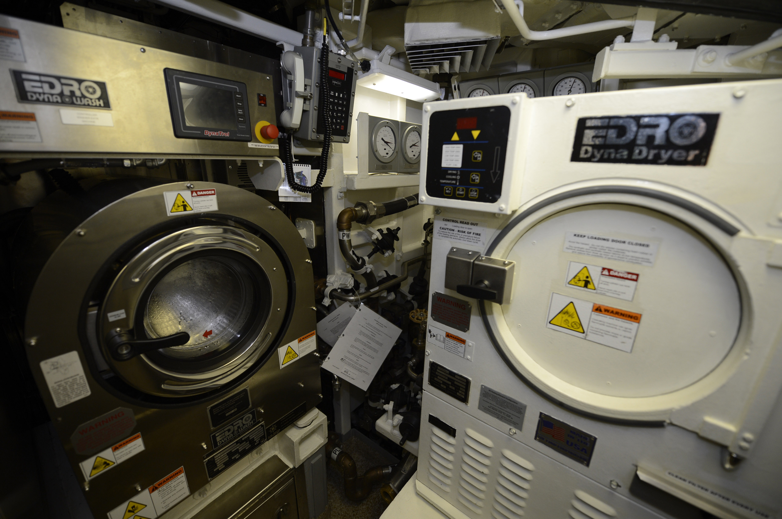
Submarine Washer and Dryer
http://navylive.dodlive.mil/2017/10/04/uss-washington-ssn-787-commissioning/

Slide 11
Vertical Integration
Developing the ability to produce goods or services previously purchased
Integration may be forward, towards the customer, or backward, towards suppliers
Can improve cost, quality, delivery, and inventory but requires capital, managerial skills, and demand
Risky in industries with rapid technological change

Slide 12
Vertical Integration
Vertical Integration Examples of Vertical Integration
Raw material (suppliers) |  |  | Tree Harvesting
Backward integration |  | Chipmakers | Pulpmaking
Current transformation | Pepsi | Apple | International Paper
Forward integration | Bottling | Retail stores | End-User Paper Conversion
Finished goods (customers)
Figure 11.2

Slide 13
Joint Ventures
Formal collaboration
Enhance skills
Secure supply
Reduce costs
The challenge is to cooperation without diluting brand or conceding competitive advantage
Example: Research at small company (F&O)

Slide 14
Keiretsu Networks
A middle ground between few suppliers and vertical integration
Supplier becomes part of the company coalition
Often provide financial support for suppliers through ownership or loans
Members expect long-term relationships and provide technical expertise and stable deliveries
May extend through several levels of the supply chain
Example:

Slide 15
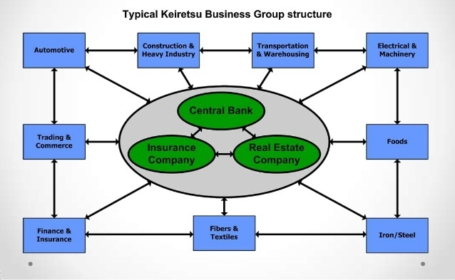
Keiretsu Example

Slide 16
Virtual Companies
Rely on a variety of supplier relationships to provide services on demand
Fluid organizational boundaries that allow the creation of unique enterprises to meet changing market demands
Relationships may be short- or long-term
Exceptionally lean performance, low capital investment, flexibility, and speed
Example: Consulting

Slide 17
Sourcing Strategies
What sourcing strategy would you use for the following? (Solutions next slide)
Finding people to work on a phone app
Controlling production costs for ice cream along the entire supply chain
Small company needing skills to complete a project
Selecting paper for the company office
Developing a one-of-a-kind part

Slide 18
Sourcing Strategies - SOL
Virtual companies
Vertical integration
Joint venture
Many suppliers
Few suppliers

Slide 19
Supply Chain Risk
More reliance on supply chains means more risk
More complicated = More risk
Fewer suppliers increase dependence
Compounded by globalization and logistical complexity
Vendor reliability and quality risks
Political and currency risks
See Table 11.3

Slide 20
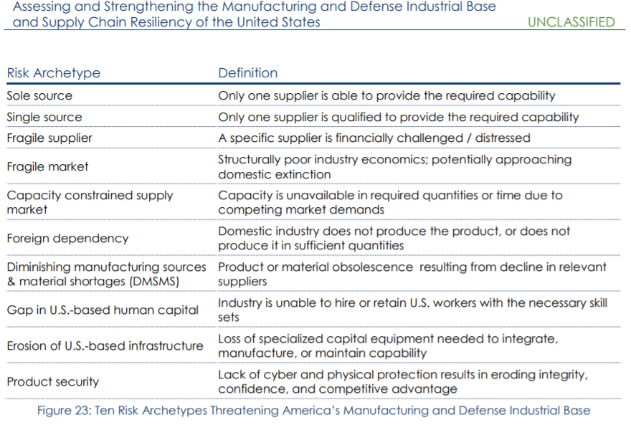
Risk in DoD

Slide 21
Building the Supply Base
Supplier evaluation
Finding potential suppliers
Determine likelihood of their becoming good suppliers
Supplier certification
Qualification
Education
Certification - external

Slide 22
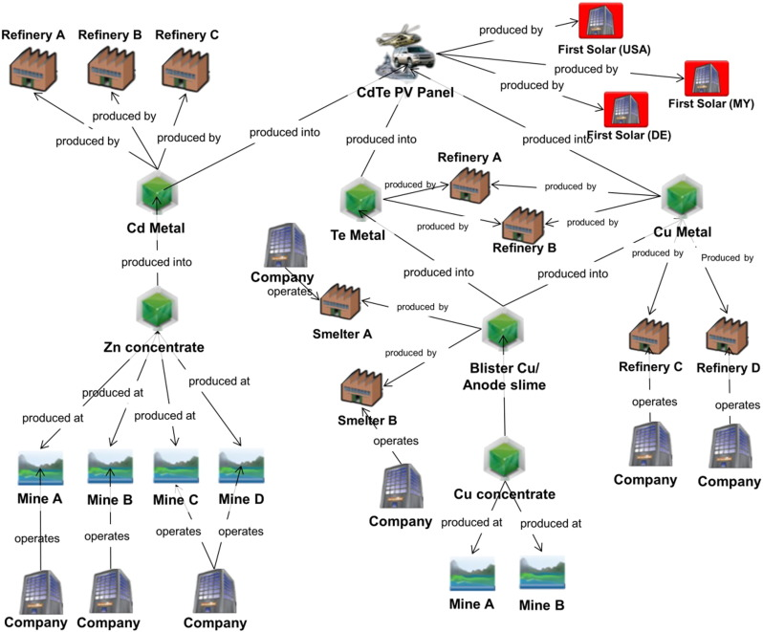
Supply Chain Example
https://ars.els-cdn.com/content/image/1-s2.0-S2214993716300318-gr1.jpg

Slide 23
Supply Chain Templates
Strategic Supply Chain Mapping Approaches
John T. Gardner
SUNY Brockport
Martha C. Cooper
Ohio State University
Journal of Business Logistics, Vol.24, No.2, 2003
Link
https://pdfs.semanticscholar.org/6cd0/25fd30d1441935eb8bd6f1511cdc22cc0294.pdf
Optional reading for more details

Slide 24
Measuring Performance
Inventory turnover
Inventory
turnover
Cost of goods sold
Average inventory investment
=
Inventory investment
Average of several periods
(beginning plus ending)/2
Ending inventory

Slide 25
Measuring Performance
From PepsiCo, Inc. Annual Report
All values in billions
Net revenue |  |  |  | $32.5
Cost of goods sold |  |  |  | $14.2
Inventory:
Raw material inventory |  | $.74
Work-in-process inventory |  | $.11
Finished goods inventory |  | $.84
Total inventory investment |  |  |  | $1.69
Inventory
turnover
14.2
1.69
= = 8.4

Slide 26
Measuring Performance
TABLE 11.6 | Examples of Annual Inventory Turnover
FOOD, BEVERAGE, RETAIL
Anheuser Busch |  | 15
Coca-Cola |  | 14
Home Depot |  | 5
McDonald’s |  | 112
MANUFACTURING
Dell Computer |  | 90
Johnson controls |  | 22
Toyota (overall) |  | 13
Nissan (assembly) |  | 150

Slide 27
Measuring Performance
Weeks of supply
Weeks of supply
Average inventory investment
Annual cost of goods sold
52 weeks
=
For PepsiCo
Inventory investment = $1.69 billion
Avg weekly cost of goods sold = $14.2 billion / 52 = $0.27 billion
Weeks of supply = 1.69 / .27 = 6.2 weeks

Slide 28
Benchmarking the Supply Chain
Comparison with benchmark firms
TABLE 11.7 | Supply Chain Metrics in the Consumer Packaged Goods Industry
 |  | TYPICAL FIRMS | BENCHMARK FIRMS
Order fill rate |  | 71% | 98%
Order fulfillment lead time (days) |  | 7 | 3
Cash-to-cash cycle time (days) |  | 100 | 30
Inventory days of supply |  | 50 | 20

Slide 29
The Bullwhip Effect
The tendency for larger order size fluctuations as orders are relayed through the supply chain
Creates unstable production schedules, expensive capacity change costs, longer lead times, obsolescence
Damage can be minimized with supplier coordination and planning
Need to understand idea of safety stock

Slide 30
The Bullwhip Effect
60 –
50 –
40 –
30 –
20 –
10 –
0 –
Suppliers believe sales are huge and respond accordingly
Wholesalers order even more to be sure retailers can be adequately supplied
Suppliers
Wholesalers
Retailers
Consumers
Retailers respond by ordering more
Order Quantity
A short-term increase in consumer demand
| | | | | | | | | | | |
1 2 3 4 5 6 7 8 9 10 11
Day
Figure S11.2

Slide 31
Bullwhip Effect
No Bullwhip Effect
Normal Order
Safety Stock
With Bullwhip Effect
Extra Order
Normal Order
Safety Stock
Customer
Store
Wholesaler
Distributor
Manufacturer
Supplier

Slide 32
Bullwhip Effect
Normal Order
Back Orders
Customer
Store
Wholesaler
Distributor
Manufacturer
Supplier
Back Orders
Normal Order
Customer
Store
Wholesaler
Distributor
Manufacturer
Supplier
Safety Stock

Slide 33
Managing the Bullwhip Effect
TABLE S11.1 | The Bullwhip Effect
CAUSE |  | REMEDY
Demand forecast errors (cumulative uncertainty in the supply chain) |  | Share demand information throughout the supply chain
Order batching (large, infrequent orders leading suppliers to order even larger amounts) |  | Channel coordination: Determine lot sizes as though the full supply chain was one company
Price fluctuations (buying in advance of demand to take advantage of low prices, discounts, coupons, or sales) |  | Price stabilization (everyday low prices)
Shortage gaming (hoarding supplies for fear of a supply shortage) |  | Allocate orders based on past demand

Slide 34
The Bullwhip Effect Measure
If measure is:
> 1 ➔ Variance amplification is present
= 1 ➔ No amplification is present
< 1 ➔ Smoothing or dampening is occurring

Slide 35
Calculating the Bullwhip Effect
Transform sheet steel to tabletops
Each firm in the supply chain has one supplier and one customer
FIRM | VARIANCE OF DEMAND | VARIANCE OF ORDERS | BULLWHIP MEASURE
Furniture Mart, Inc. | 100 | 110 | 110/100 = 1.10
Furniture Distributors, Inc. | 110 | 180 | 180/110 = 1.64
Furniture Makers of America | 180 | 300 | 300/180 = 1.67
Chieh Lee Metals, Inc. | 300 | 750 | 750/300 = 2.50
Metal Suppliers Ltd. | 750 | 2000 | 2000/750 = 2.67

Slide 36
Bullwhip Calculation
The supplier order variances are 34 and is experiencing a demand variance of 23.
Would you expect there to be a bullwhip effect; if so, how bad is it?
34/23 = 1.5
>1 = Bullwhip effect present
Recommended action
Immediate
Decrease order
Long-term
Increase communication through supply chain

Slide 37
Additional Info
To assist with homework

Slide 38
Supply Chain Management
TABLE 11.2 | How Corporate Strategy Impacts Supply Chain Decisions
 |  | LOW COST STRATEGY | RESPONSE STRATEGY | DIFFERENTIATION STRATEGY
Primary supplier selection criteria |  | Cost | Capacity Speed Flexibility | Product development skills Willing to share information Jointly and rapidly develop products
Supply chain inventory |  | Minimize inventory to hold down costs | Use buffer stocks to ensure speedy supply | Minimize inventory to avoid product obsolescence
Distribution network |  | Inexpensive transportation Sell through discount distributors/ retailers | Fast transportation Provide premium customer service | Gather and communicate market research data Knowledgeable sales staff
Product design characteristics |  | Maximize performance Minimize cost | Low setup time Rapid production ramp-up | Modular design to aid product differentiation

Slide 39
Risk and Mitigation Tactics
TABLE 11.3 |  | Supply Chain Risks and Tactics
RISK | RISK REDUCTION TACTICS |  | EXAMPLE
Supplier failure to deliver | Use multiple suppliers; effective contracts with penalties; subcontractors on retainer; pre-planning |  | McDonald's planned its supply chain 6 years before its opening in Russia. Every plant—bakery, meat, chicken, fish, and lettuce—is closely monitored to ensure strong links.
Supplier quality failures | Careful supplier selection, training, certification, and monitoring |  | Darden Restaurants has placed extensive controls, including third-party audits, on supplier processes and logistics to ensure constant monitoring and reduction of risk.

Slide 40
Risk and Mitigation Tactics
TABLE 11.3 |  | Supply Chain Risks and Tactics
RISK | RISK REDUCTION TACTICS |  | EXAMPLE
Outsourcing | Take over production; provide or perform the service yourself |  | Tyson took over chicken farm production in China to mitigate product quality and safety concerns related to using independent farmers
Logistics delays or damage | Multiple/redundant transportation modes and warehouses; secure packaging; effective contracts with penalties |  | Walmart, with its own trucking fleet and numerous distribution centers located throughout the U.S., finds alternative origins and delivery routes bypassing problem areas.

Slide 41
Risk and Mitigation Tactics
TABLE 11.3 |  | Supply Chain Risks and Tactics
RISK | RISK REDUCTION TACTICS |  | EXAMPLE
Distribution | Careful selection, monitoring, and effective contracts with penalties |  | Toyota trains its dealers around the world, invoking principles of the Toyota Production System to help dealers improve customer service, used-car logistics, and body and paint operations.
Information loss or distortion | Redundant databases; secure IT systems; training of supply chain partners on the proper interpretations and uses of information |  | Boeing utilizes a state-of-the-art international communication system that transmits engineering, scheduling, and logistics data to Boeing facilities and suppliers worldwide.

Slide 42
Risk and Mitigation Tactics
TABLE 11.3 |  | Supply Chain Risks and Tactics
RISK | RISK REDUCTION TACTICS |  | EXAMPLE
Political | Political risk insurance; cross-country diversification; franchising and licensing |  | Hard Rock Café reduces political risk by franchising and licensing, rather than owning, when the political and cultural barriers seem significant.
Economic | Hedging to combat exchange rate risk; purchasing contracts that address price fluctuations |  | Honda and Nissan are moving more manufacturing out of Japan as the exchange rate for the yen makes Japanese-made autos more expensive.

Slide 43
Risk and Mitigation Tactics
TABLE 11.3 |  | Supply Chain Risks and Tactics
RISK | RISK REDUCTION TACTICS |  | EXAMPLE
Natural catastrophes | Insurance; alternate sourcing; cross-country diversification |  | Toyota, after its experience with fires, earthquakes, and tsunamis, now attempts to have at least two suppliers, each in a different geographical region, for each component.
Theft, vandalism, and terrorism | Insurance; patent protection; security measures including RFID and GPS; diversification |  | Domestic Port Radiation Initiative: The U.S. government has set up radiation portal monitors that scan nearly all imported containers for radiation.

Slide 44
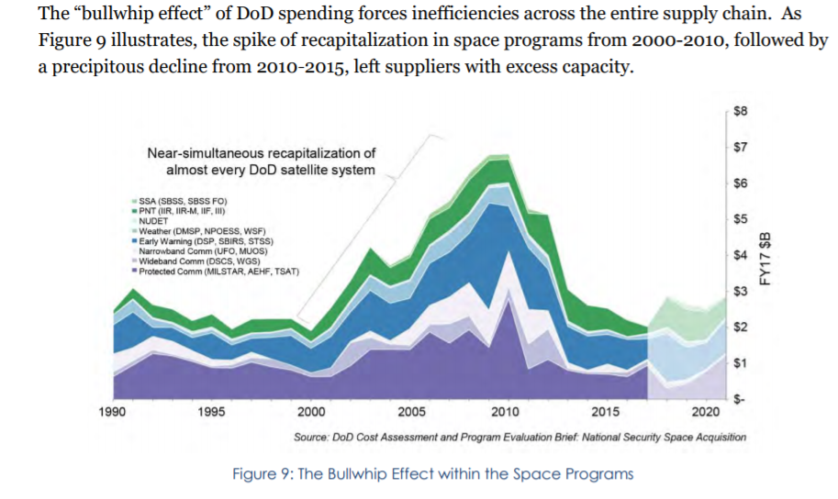
Bull Whip Effect & NASA
https://media.defense.gov/2018/Oct/05/2002048904/-1/-1/1/ASSESSING-AND-STRENGTHENING-THE-MANUFACTURING-AND%20DEFENSE-INDUSTRIAL-BASE-AND-SUPPLY-CHAIN-RESILIENCY.PDF

